Slide 1
Principles of multimedia
Week 12
Video

Slide 2
Crunching a few numbers
Data you need to view a YouTube video
Size: 360 x 640
Frame rate: 30fps
Bit rate = H x W x fps x num of colors x bits per color
= 360 x 640 x 30 x 3 x 8 bps
= 165,888,000 bps
= 170 Mbps (approx)
So, viewing this over a typical 2Mbps connection would require a compression by a factor of about 85.
Similarly, a 1 GB storage device would be able to hold less than one minute long video content
03/11/15
Notes:
<number>
Before discussing video compression standards, let us examine why video compression is important. Video compression is necessary to make many video applications practical. This is because raw video contains an immense amount of data. Most video applications require the communication or storage of video. These capabilities are usually limited and/or very expensive.
Consider, for example, video transmission within high-definition television, or HDTV. A popular HDTV video format is progressively scanned at 720x1280 pixels/frame, 60 frames/s video signal, with 24-bits/pixel, 8 bits each for red, green and blue, which corresponds to a raw data rate of about 1.3 Gbits/sec. With modern digital communications, we can only transmit about 20 Mb/s in the 6 MHz bandwidth allocated per television channel. Therefore, powerful video compression techniques are applied to compress the video by about a factor of 70 to send the video, which has a raw rate of 1.3 Gb/s, through the available 20 Mb/s channel. As will be discussed later in this presentation, the MPEG-2 video compression standard is used to compress HDTV video.

Slide 3
Different applications and indicative bit-rates
16 kbit/s Videophone
128–384 kbit/s video conferencing
1.15 Mbit/s VCD
3.5 Mbit/s SD TV
9.8 Mbit/s DVD
10 to 40 Mbit/s HD
03/11/15

Slide 4
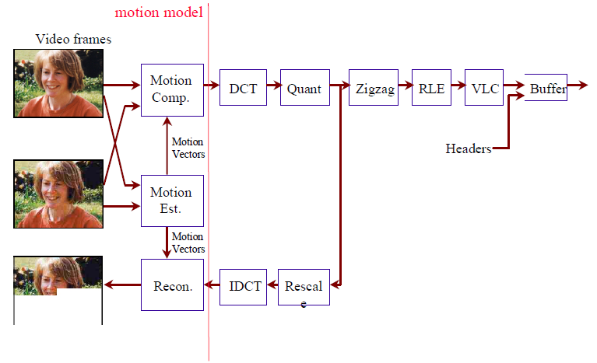
Video encoder
03/11/15

Slide 5
03/11/15

Slide 6
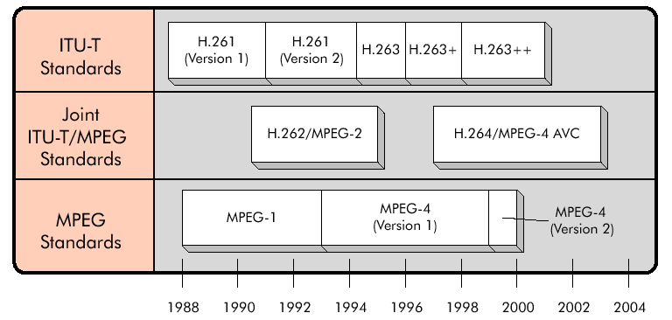
Timeline of the open standards
03/11/15

Slide 7
Why Standards?
Your thoughts….
03/11/15
Notes:
<number>
Video compression standards provide a number of benefits, foremost of which is facilitating interoperability. By ensuring interoperability, standards lower the risk for both consumers and manufacturers. This results in quicker acceptance and widespread use. In addition, these standards are designed for a wide variety of applications. The resulting economies of scale lead to reduced cost and greater use.

Slide 8
Containers & Codecs
Containers
Container is a wrapper or a format specification for different data elements to reside together.
Codecs
Compressor/decompressor or coder/decoder. Strictly speaking, the codec is the program which does the comp-decomp as per a format or standard. However, codec is also used to refer to the format. Different audio, video and also speech codecs in use.
03/11/15
Notes:
RTP normally uses UDP though it is specified over TCP also.
<number>

Slide 9
Streaming
RTSP (Real time streaming protocol)
Uses RTP (Real-time transport protocol) & RTCP (Real time control protocol) for multimedia delivery. RTSP maintains state.
RTMP (Real time messaging protocol)
Developed by Adobe and available as an open standard.
FMS (Flash Media Server) uses this.
HTTP Live streaming (HLS)
Developed by Apple.
Implements streaming by sending chunks of transport stream data as files over http. Since these are standard http transactions, it is more amenable to working with firewalls and proxies.
03/11/15
Notes:
RTP normally uses UDP though it is specified over TCP also.
<number>

Slide 10
Containers & Codecs
03/11/15
Notes:
Add QT
<number>

Slide 11
What Do the Standards Specify?
A video compression system consists of the following:
An encoder
Compressed bit-streams
A decoder
03/11/15
Notes:
<number>
An important question is what does a video compression standard actually specify? A video compression system is composed of an encoder, compressed bit-streams, and a decoder. The encoder takes original video and compresses it to a bit-stream. The bit-stream is passed to the decoder which decodes it to produce the reconstructed video. One possibility is that the standard would specify both the encoder and decoder, but this approach would have a number of disadvantages. Instead, the standards have a limited scope to ensure interoperability while enabling as much differentiation as possible.

Slide 12
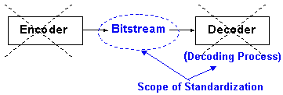
What the Standards Specify
Not the encoder, not the decoder.
03/11/15
Notes:
<number>
The standards do not specify the encoder or the decoder. Instead they specify the bit-stream syntax and the decoding process. The bit-stream syntax is the format for representing the compressed data. The decoding process is the set of rules for interpreting the bit-stream. Note that specifying the decoding process is different from specifying a particular decoder implementation. For example, the standard may specify that the decoder uses an IDCT, but not how to implement the IDCT. The IDCT may be implemented in a direct form, or by a fast algorithm similar to the FFT, and may be optimized to specific targets like DSP. The specific implementation is not standardized. This allows different designers and manufacturers to differentiate their work.
The encoding process is also not standardized. For example, more sophisticated encoders can be designed that provide improved performance over baseline encoders. In addition, improvements can be incorporated even after a standard is finalized. For instance, improved algorithms for motion estimation or bit allocation may be incorporated in the future in a standard-compatible manner. The only constraint is that the encoder produces a syntactically correct bit-stream that can be properly decoded by a standard-compatible decoder. Because of these issues, it is important to remember that not all encoders are created equal.

Slide 13
…what the Standards Specify?
Just the bit-stream syntax and the decoding process, for example it tells to use IDCT, but not how to implement the IDCT.
Enables improved encoding and decoding strategies to be employed in a standard-compatible manner.
03/11/15
Notes:
<number>
The standards do not specify the encoder or the decoder. Instead they specify the bit-stream syntax and the decoding process. The bit-stream syntax is the format for representing the compressed data. The decoding process is the set of rules for interpreting the bit-stream. Note that specifying the decoding process is different from specifying a particular decoder implementation. For example, the standard may specify that the decoder uses an IDCT, but not how to implement the IDCT. The IDCT may be implemented in a direct form, or by a fast algorithm similar to the FFT, and may be optimized to specific targets like DSP. The specific implementation is not standardized. This allows different designers and manufacturers to differentiate their work.
The encoding process is also not standardized. For example, more sophisticated encoders can be designed that provide improved performance over baseline encoders. In addition, improvements can be incorporated even after a standard is finalized. For instance, improved algorithms for motion estimation or bit allocation may be incorporated in the future in a standard-compatible manner. The only constraint is that the encoder produces a syntactically correct bit-stream that can be properly decoded by a standard-compatible decoder. Because of these issues, it is important to remember that not all encoders are created equal.

Slide 14
A conceptual look at video compression.
Spatial compression
Many regions of the image are similar.
Temporal compression
The image in a frame is very similar to preceding frame.
Psychosomatic
The eye is more sensitive to certain information.
Entropy coding
Run length encoding.
Variable length codes
03/11/15

Slide 15
Fundamental video compression techniques
Exploiting the redundancies
Temporal – MC-prediction and MC-interpolation
Spatial – Block DCT
Color – Color space conversion
Scalar quantization of DCT coefficients
Run-length and Huffman coding of the non-zero quantized DCT coefficients
03/11/15
Notes:
<number>
Current video compression standards achieve compression by applying the same basic principles. The temporal redundancy is exploited by applying MC-prediction. The spatial redundancy is exploited by applying the DCT. The color space redundancy is exploited by a color space conversion. The resulting DCT coefficients are quantized and the non-zero quantized DCT coefficients are run-length and Huffman coded to produce the compressed bit-stream.

Slide 16
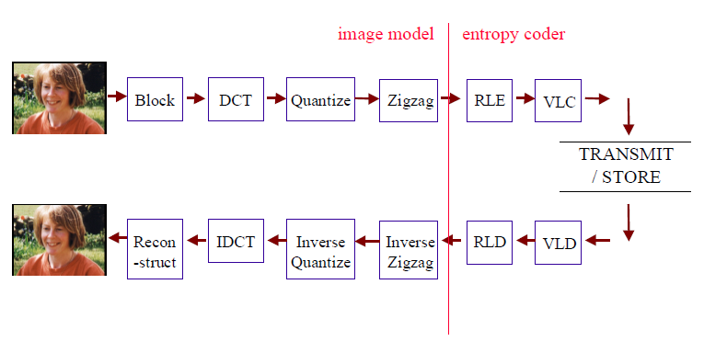
DCT based Image compression
03/11/15

Slide 17
Video encoder
03/11/15

Slide 18
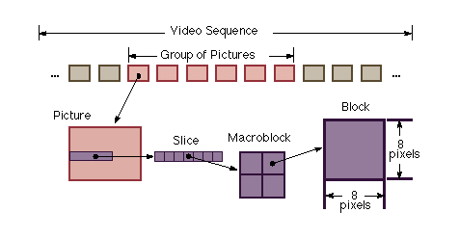
Video data hierarchy
Hierarchy
Sequence layer
GOP layer
Picture layer
Slices
Macroblock
Block (8x8 pixels)
I-, P-, or B-type
16 x 16 pixels
16 x 16 pixels
03/11/15

Slide 19
Video Stream Data Hierarchy
03/11/15
Notes:
<number>

Slide 20
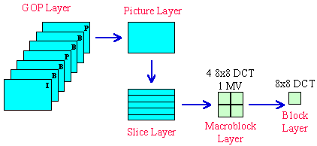
Video Structure
MPEG Structure
03/11/15
Notes:
<number>
The MPEG standard codes video in a hierarchy of units called sequences, pictures, groups of pictures, slices, macro-blocks, and DCT blocks. MC-prediction is performed on 16x16-pixel blocks. A 16x16-pixel block is called a macro-block and is coded using 8x8-pixel block DCTs, typically four 8x8-pixel blocks for luminance, two for chrominance, and possibly a forward and/or backward motion vector. The macro-blocks are scanned in a left-to-right, top-to-bottom fashion. A series of these macro-blocks form a slice. All the slices in a frame comprise a picture. Contiguous pictures form a GOP. The GOPs form the entire sequence.

Slide 21
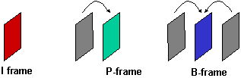
Video Compression
Main addition over image compression
Exploit the temporal redundancy
Predict current frame based on previously coded frames
Types of coded frames:
I-frame – Intra-coded frame, coded independently of all other frames
P-frame – Predictively coded frame, coded based on previously coded frame
B-frame – Bi-directionally predicted frame, coded based on both previous and future coded frames
03/11/15
Notes:
<number>
A video sequence consists of a sequence of video frames or images. Each frame may be coded as a separate image, for example by independently applying JPEG-like coding to each frame. However, video has the property that neighboring video frames are typically very similar. Video compression can achieve much higher compression ratios than image compression by exploiting this temporal redundancy or similarity between frames.
The fact that neighboring frames are highly similar can be exploited by coding a given frame by first predicting it based on a previously coded frame and then coding the prediction error. There are three basic types of coded frames: I-frames are intra-coded frames; that is, frames that are coded independently of all other frames; predictively coded, or P-frames, where the frame is coded based on a previously coded frame; and bi-directionally predicted frames, or B-frames, where the frame is coded using both previous and future coded frames.

Slide 22
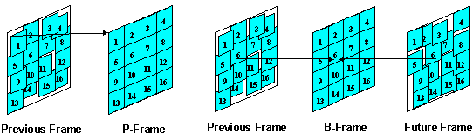
Motion Compensated Prediction
(P and B Frames)
Motion compensated prediction – predict the current frame based on a reference frame while compensating for the motion
Examples of block-based motion-compensated prediction for P-frames and B-frames.
03/11/15
Notes:
<number>
Consecutive video frames typically contain the same imagery, although possibly at different spatial locations. To exploit the predictability among neighboring frames, it is important to estimate the motion between the frames and then form an appropriate prediction while compensating for the motion. The process of estimating the motion between frames is known as motion estimation. The process of predicting a given frame based on the previously coded reference frame, while compensating for the relative motion between the two frames, is referred to as motion-compensated prediction.
Block-based, motion-compensated prediction is often used because it achieves good performance and has a basic, periodic structure that simplifies implementations. Examples of block-based forward and bi-directional motion-compensated prediction are illustrated on the left and right, respectively. The current frame to be coded is partitioned into 16x16-pixel blocks. For each block in the current frame, a prediction is formed by finding the best-matching block in a previously coded reference frame. The displacement or relative motion for the best-matching block is referred to as motion vector.

Slide 23
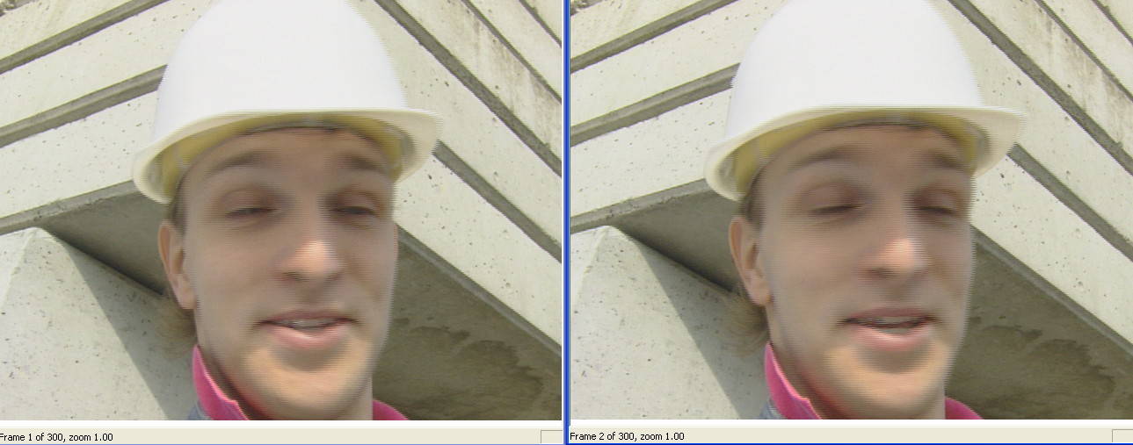
Check out how similar consecutive frames are
Frame 1
Frame 2
03/11/15
Notes:
<number>

Slide 24
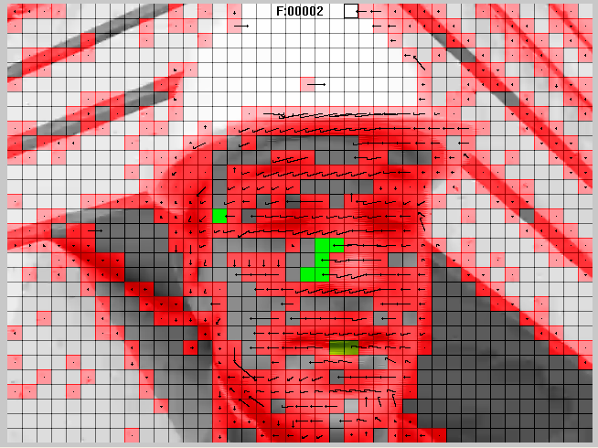
Residual Coding
Residual after motion compensation coded.
03/11/15
Notes:
<number>

Slide 25
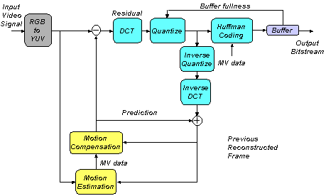
Example Video Encoder
03/11/15
Notes:
<number>
This page and the next illustrate high-level views of a typical video encoder and decoder. As previously discussed, the various standards specify the bit-stream syntax and the decoding process, but not the encoder processing or the specific decoder implementation. Therefore, these figures should be viewed only as examples of typical encoders and decoders in a video compression system.
In the encoder, the input RGB video signal is first transformed into a luminance/chrominance color space, a YUV, to exploit the color space redundancy. To exploit the temporal redundancy, motion estimation and motion-compensated prediction are used to form a prediction of the current frame from the previously encoded frame. The prediction error, or residual, is partitioned into 8x8 blocks and the 2-D DCT is computed for each block. The DCT coefficients are adaptively quantized to exploit the local video characteristics, human perception, and to meet any bit-rate targets. The quantized coefficients and other information are Huffman coded for increased efficiency. Often a buffer is used to couple the variable bit-rate output of the video encoder to the desired channel. This is accomplished via a buffer control mechanism whereby the buffer fullness is used to regulate the coarseness versus fineness of the coefficient of quantization, and thereby the video bit-rate.

Slide 26
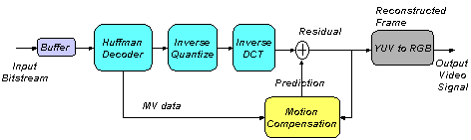
Example Video Decoder
03/11/15
Notes:
<number>
The video decoding process is the inverse of the encoding process. The bit-stream is parsed and Huffman decoded. The non-zero DCT coefficients are identified and the inverse quantized. An inverse block DCT operation produces the residual signal, which is combined in a spatially adaptive manner with the previously reconstructed frame to reconstruct the current frame. Finally, the reconstructed frame is converted back to the RGB color space to produce the output video signal.

Slide 27
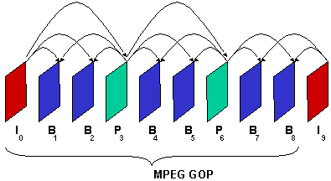
Group of Pictures (GOP) Structure
Enables random access into the coded bit-stream.
Number of B frames and impact on search range.
03/11/15
Notes:
<number>
This page and the next highlight the basic structures used in the MPEG standards. The MPEG standards group video frames into coding units called groups of pictures, or GOPs. GOPs have the property of re-initializing the temporal prediction used during encoding, which is important to enable random access into a coded video stream. Specifically, the first frame of a GOP is an I-frame and the other frames may be I, P, or B frames. In this example, the GOP contains nine video frames, I₀ through B₈, where the subscript indicates the frame number. Frame I₉ is the first of the next GOP. The arrows indicate the prediction dependencies. The frame at the base of each arrow, the anchor frame, is used to predict the frame at the tip of the arrow, the predicted frame.
I frames are coded independently of other frames. P frames depend on the prediction based on the preceding I or P frame. B frames depend on a prediction based on the preceding and following I or P frames. Notice that each B frame depends on data from a future frame, which means that the future frame must be de-coded before the current B frame can be de-coded. Also note that the use of B frames adds additional delay. Therefore, while B frames are fine for broadcast or storage applications, they are often not appropriate for use in real-time, two-way communications or other applications where low delay is a requirement.

Slide 28
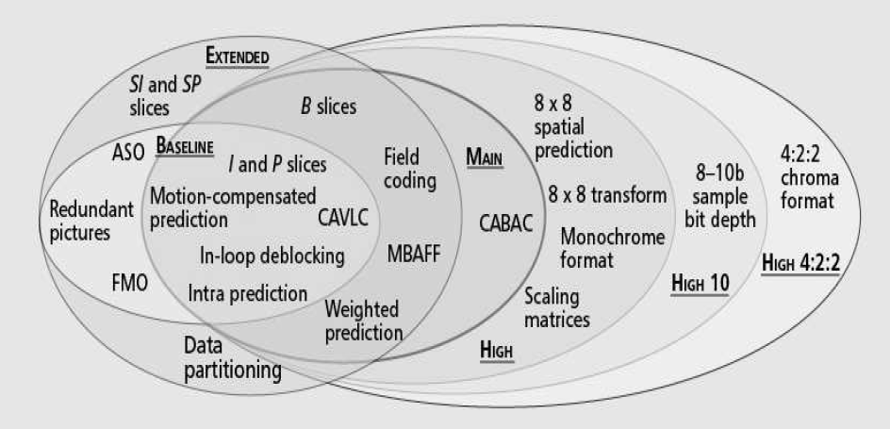
H.264/AVC Profiles
03/11/15
Notes:
<number>

Slide 29
A look at different standards
Feature | MPEG4 | WMV9 | H.264
Prediction Block size | 16*16, 8*8 | 16*16, 16*8, 8*8 , 4*4 | 4*4,4*8,8*4,8*8, 8*16,16*8,16*16
Intra Prediction | Ac Prediction (Transform Domain) | Ac Prediction (Transform Domain) | Intra Prediction (Spatial Domain)
Entropy coding | VLC | VLC | CAVLC,CABAC
Reference frame | One picture | Two (Interlace) | Multiple pictures
Weighted Prediction | No | No | Yes
De-blocking Filter | No (Optional) | Yes | Yes
Transform | 8*8 DCT | 4*4,4*8,8*4,8*8 | 4*4,8*8(High Profile) Integer DCT
Notes:
<number>

Slide 30
Exercise
Take two pictures in quick succession of the same scene with a human in it. Compute the motion vectors for each 8x8 block in the second picture. Let the search space be all blocks that are offset by 1 and 2 pixels in x, y or both.
Depict the motion vectors computed above using an image showing empty blocks and the vectors superimposed on it. Use two pixels to denote offset by 1.
Use FFmpeg and extract all the frames of foreman video

